Slide 1
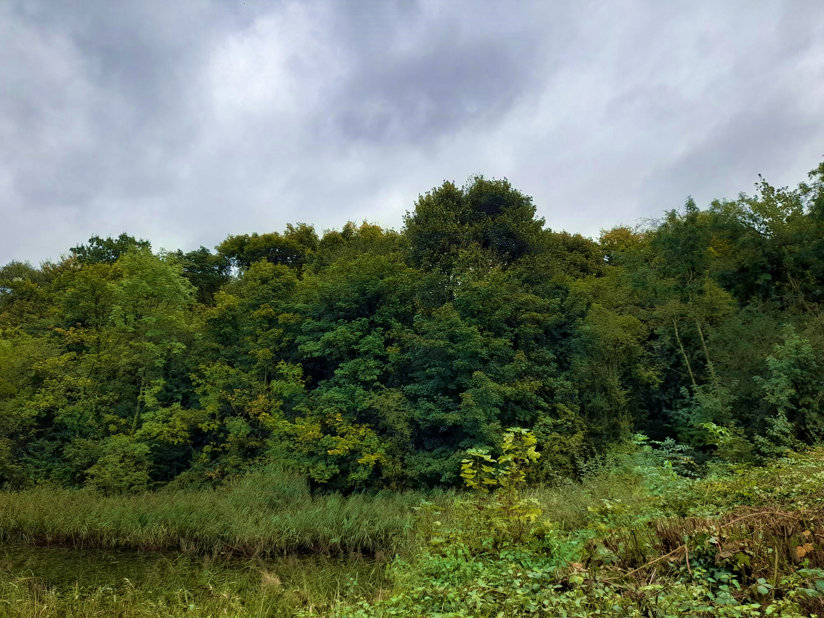
MERCIAN WOODLAND BIODIVERSITY PROJECT
-- selective tree felling this winter

Slide 2
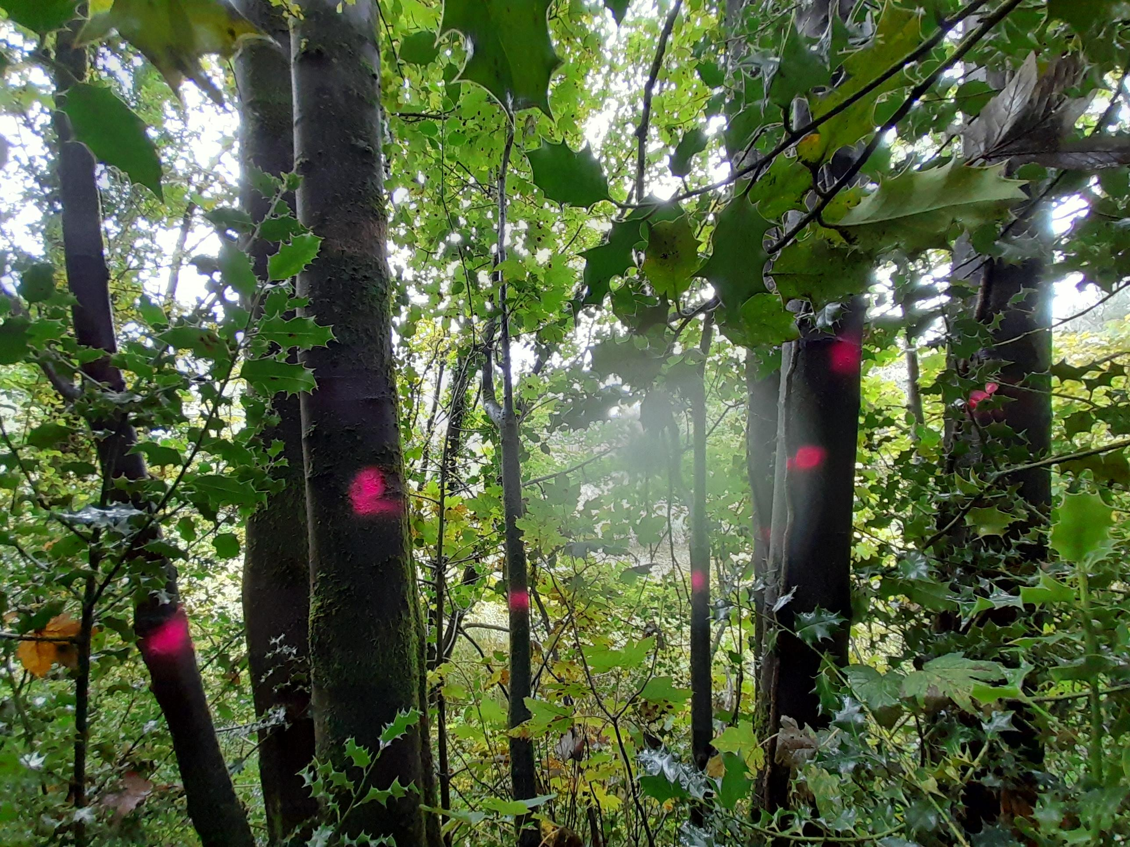
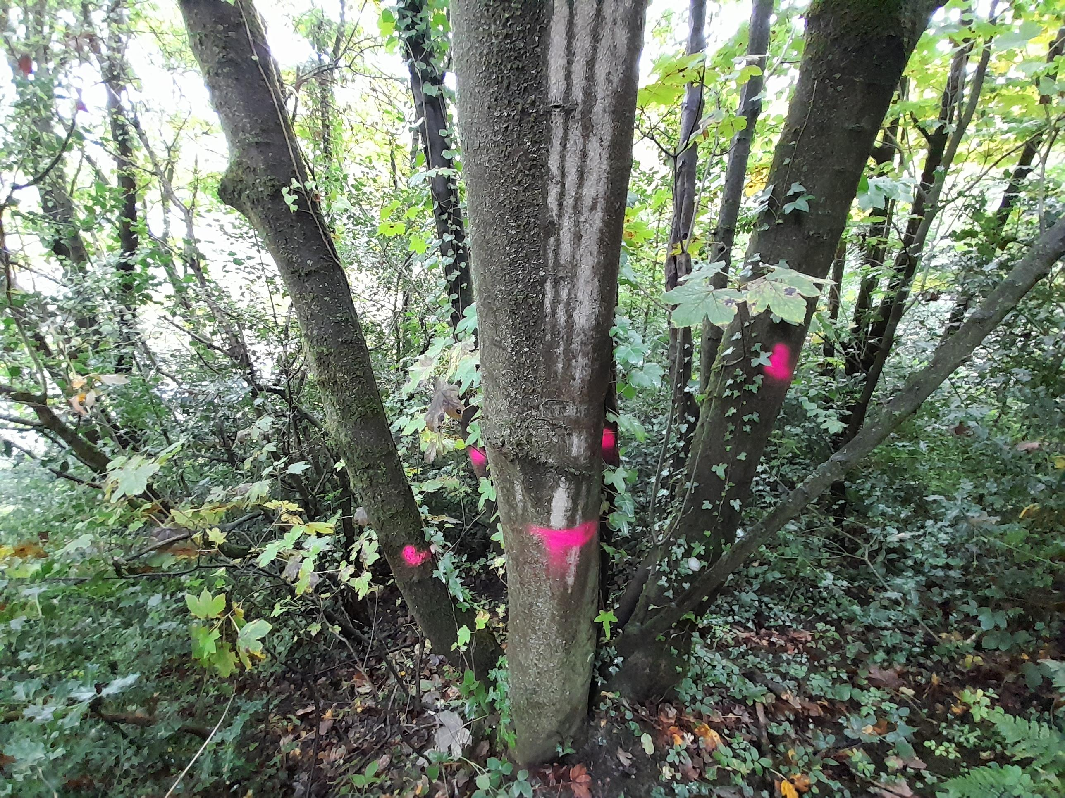
On the steep bank behind the top, Round, Pool, there are a large number of self set sycamore trees. They are very tall, as they all fight for light, and the largest amongst them are tall enough to affect the views from the top of the mound. It has long been the wish of many people who love Paddock Mound, to try to reinstate these views. Taking out some of the trees will have an additional, and very important result, in adding much needed biodiversity to the woodland.

Slide 3

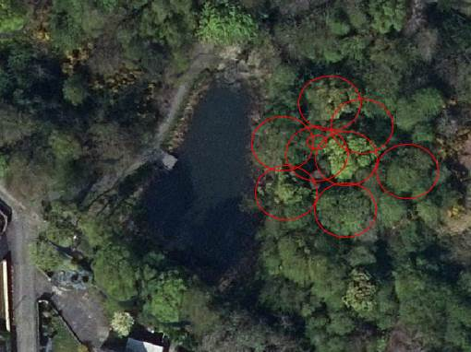
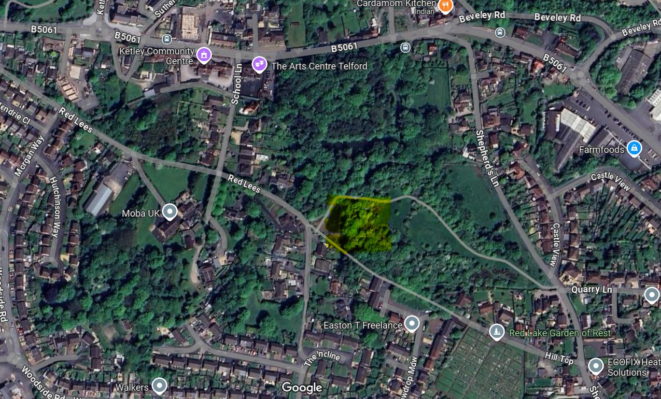
Amongst the interventions earmarked to improve the biodiversity of Paddock Mound, the Small Woods association have surveyed the site as part of the Severn Trent funded five year project. There is a lack of dead wood throughout the woodland, and some ring barking to create standing dead wood has already taken place. The larger intervention on the bank behind the round pool will only take out a few selected trees, but this will allow for more light, and enable some planting of new species to promote increase in species biodiversity and resilience of woodland composition, for instance native Yew, Crab Apple and Wild Cherry. The felled wood will be retained as eco piles to increase invertebrate and small mammal habitat, shelter and overwintering sites.
The two images below show the rough location of the trees to be felled. smallwoods.org.uk/mercian

